Slide 1


COMPUTEROME 2.0
USERS WORKSHOP
CENTER FOR HEALTH DATA SCIENCE (HEADS)
FACULTY OF HEALTH AND MEDICAL SCIENCES,
UNIVERSITY OF COPENHAGEN, APRIL 2021

Slide 2
PART6
PTIMIZING THE UTALIZATION OF C2: TIME, MEMORY AND COST

Slide 3

WHY IS IT IMPORTANT TO OPTIMIZE?

Slide 4



SAVING MONEY BY OPTIMIZATION
C2 pricing model: quantized per node
You pay per node, not how many cores or CPUs you used.
Remember C2 architecture – CPUs are distributed 40 per node
C2 is like a bar of chocolate
You pay per bar, now how many pieces you have eaten.
PRICING
COMPUTEROME 2.0
$$$

Slide 5
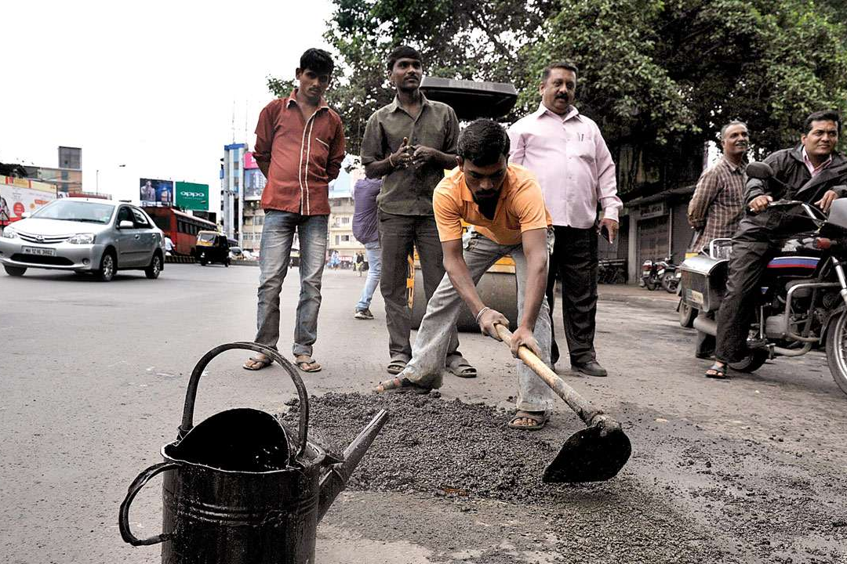
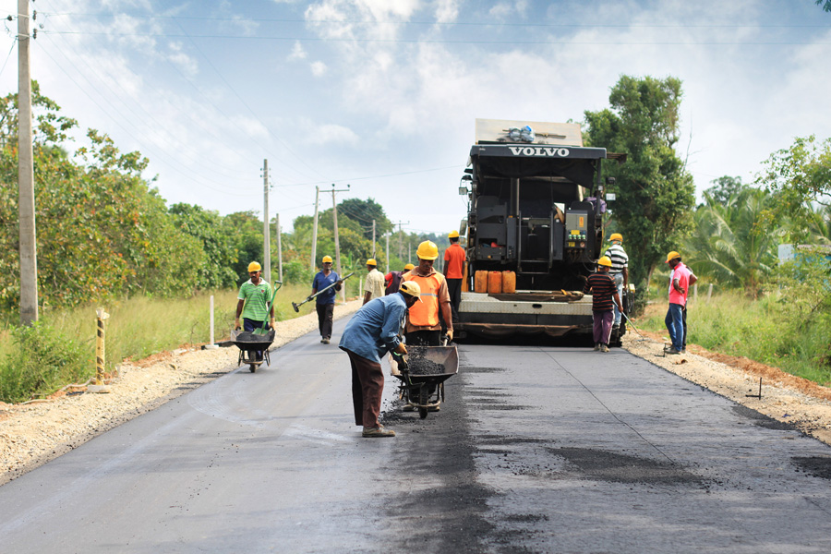
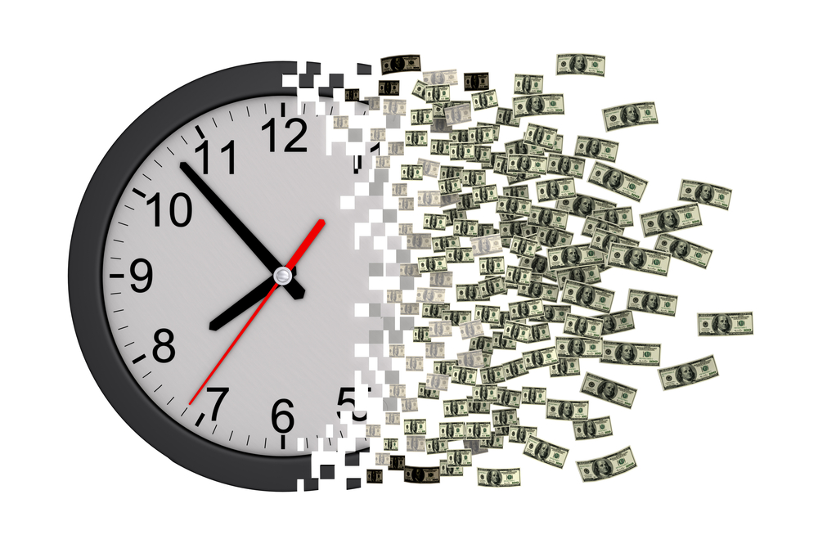
SAVING TIME BY OPTIMIZATION
PARALLELIZATION: more threads used usually means faster execution
not parallelized
parallelized

Slide 6
MEMORY OPTIMIZATION
How much memory does my job need?
Again, remember the C2 architecture
Thin compute node: 696 total thin nodes
40 cores (2CPUs with 20 cores each),
192 GB RAM
Fat compute node: 55 total fat nodes
40 cores (2 CPUs with 20 cores each), 1536 GB RAM (1.5 TB)
Since there are more thin node, the job is launched faster.
Only use the fat nodes if your job needs more than ~ 192 GB RAM.

Slide 7
If your program is not multi-threaded (or cannot use the full 40 threads), run multiple commands in the background, thus utilizing CPU bandwidth.
#!/bin/sh
#PBS -W group_list=ku_fa -A ku_fa
#PBS -N test
#PBS -e test.err
#PBS -o test.log
#PBS -l nodes=1:ppn=40,mem=120gb,walltime=12:00:00
module load bwa/0.7.15
bwa mem -t 10 canFam31.fasta Batch1.R1.fastq.gz Batch1.R2.fastq.gz > Batch1.out &
bwa mem -t 10 canFam31.fasta Batch2.R1.fastq.gz Batch2.R2.fastq.gz > Batch2.out &
bwa mem -t 10 canFam31.fasta Batch3.R1.fastq.gz Batch3.R2.fastq.gz > Batch3.out &
bwa mem -t 10 canFam31.fasta Batch4.R1.fastq.gz Batch4.R2.fastq.gz > Batch4.out &
wait
CORE/CPU USAGE OPTIMIZATION

Slide 8
If your program is not multi-threaded (or cannot use the full 40 threads), run multiple commands in the background, thus utilizing CPU bandwidth.
#!/bin/sh
#PBS -W group_list=ku_fa -A ku_fa
#PBS -N test
#PBS -e test.err
#PBS -o test.log
#PBS -l nodes=1:ppn=40,mem=120gb,walltime=12:00:00
module load bwa/0.7.15
bwa mem -t 10 canFam31.fasta Batch1.R1.fastq.gz Batch1.R2.fastq.gz > Batch1.out &
bwa mem -t 10 canFam31.fasta Batch2.R1.fastq.gz Batch2.R2.fastq.gz > Batch2.out &
bwa mem -t 10 canFam31.fasta Batch3.R1.fastq.gz Batch3.R2.fastq.gz > Batch3.out &
bwa mem -t 10 canFam31.fasta Batch4.R1.fastq.gz Batch4.R2.fastq.gz > Batch4.out &
wait
CORE/CPU USAGE OPTIMIZATION

Slide 9
How much time to execute a program?
Run a single job first to estimate time and use this as a guide to figure out how much time other similar jobs might require.
Use the /usr/bin/time command OR use qstat.
ESTIMATING RESOURCE REQUIREMENTS
#!/bin/bash
#PBS -W group_list=ku_fa -A ku_fa
#PBS -N test
#PBS -e test.err
#PBS -o test.log
#PBS -l nodes=1:ppn=40,mem=120gb,walltime=12:00:00
module load bwa/0.7.15
/usr/bin/time -v bwa mem -t 40 canFam31.fasta Batch1.R1.fastq.gz Batch1.R2.fastq.gz > Batch1.out

Slide 10
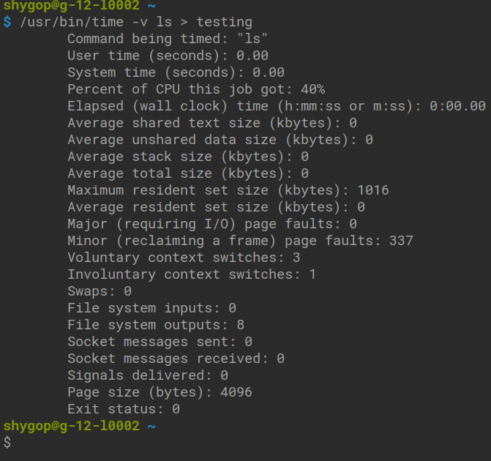
ESTIMATING RESOURCE REQUIREMENTS

Slide 11

IS THIS JOB OPTIMIZED TO LAUNCH ON COMPUTEROME?
YES, NO, WHAT IS THE PROBLEM?

Slide 12
JOB 1
#!/bin/bash
#PBS -W group_list=ku_fa -A ku_fa
#PBS -N test
#PBS -e test.err
#PBS -o test.log
#PBS -l nodes=1:ppn=10,mem=120gb,walltime=12:00:00
bwa mem -t 10 canFam31.fasta Batch1.R1.fastq.gz Batch1.R2.fastq.gz > Batch1.out &
bwa mem -t 10 canFam31.fasta Batch2.R1.fastq.gz Batch2.R2.fastq.gz > Batch2.out &
bwa mem -t 10 canFam31.fasta Batch3.R1.fastq.gz Batch3.R2.fastq.gz > Batch3.out &
bwa mem -t 10 canFam31.fasta Batch4.R1.fastq.gz Batch4.R2.fastq.gz > Batch4.out &
wait

Slide 13

Is job 1 ok to run on C2?
ⓘ Start presenting to display the poll results on this slide.
Notes:
📣 This is Slido interaction slide, please don't delete it. ✅ Click on 'Present with Slido' and the poll will launch automatically when you get to this slide.

Slide 14
JOB 2
#!/bin/bash
#PBS -W group_list=ku_fa -A ku_fa
#PBS -N test
#PBS -e test.err
#PBS -o test.log
#PBS -l nodes=1:ppn=30,mem=120gb,walltime=12:00:00
module load bwa/0.7.15
bwa mem -t 10 canFam31.fasta Batch1.R1.fastq.gz Batch1.R2.fastq.gz > Batch1.out &
bwa mem -t 10 canFam31.fasta Batch2.R1.fastq.gz Batch2.R2.fastq.gz > Batch2.out &
bwa mem -t 10 canFam31.fasta Batch3.R1.fastq.gz Batch3.R2.fastq.gz > Batch3.out &
wait

Slide 15
Is job 2 ok to run on C2?
ⓘ Start presenting to display the poll results on this slide.
Notes:
📣 This is Slido interaction slide, please don't delete it. ✅ Click on 'Present with Slido' and the poll will launch automatically when you get to this slide.

Slide 16
JOB 3
#!/bin/bash
#PBS -W group_list=ku_fa -A ku_fa
#PBS -N test
#PBS -e test.err
#PBS -o test.log
#PBS -l nodes=1:ppn=40,mem=200gb,walltime=12:00:00
module load bwa/0.7.15
bwa mem -t 10 canFam31.fasta Batch1.R1.fastq.gz Batch1.R2.fastq.gz > Batch1.out &
bwa mem -t 10 canFam31.fasta Batch2.R1.fastq.gz Batch2.R2.fastq.gz > Batch2.out &
bwa mem -t 10 canFam31.fasta Batch3.R1.fastq.gz Batch3.R2.fastq.gz > Batch3.out &
bwa mem -t 10 canFam31.fasta Batch4.R1.fastq.gz Batch4.R2.fastq.gz > Batch4.out &
wait

Slide 17
Is job 3 ok to run on C2?
ⓘ Start presenting to display the poll results on this slide.
Notes:
📣 This is Slido interaction slide, please don't delete it. ✅ Click on 'Present with Slido' and the poll will launch automatically when you get to this slide.

Slide 18
JOB 4
#!/bin/bash
#PBS -W group_list=ku_fa -A ku_fa
#PBS -N test
#PBS -e test.err
#PBS -o test.log
#PBS -l nodes=1:ppn=48,mem=160gb,walltime=12:00:00
module load bwa/0.7.15
bwa mem -t 12 canFam31.fasta Batch1.R1.fastq.gz Batch1.R2.fastq.gz > Batch1.out &
bwa mem -t 12 canFam31.fasta Batch2.R1.fastq.gz Batch2.R2.fastq.gz > Batch2.out &
bwa mem -t 12 canFam31.fasta Batch3.R1.fastq.gz Batch3.R2.fastq.gz > Batch3.out &
bwa mem -t 12 canFam31.fasta Batch4.R1.fastq.gz Batch4.R2.fastq.gz > Batch4.out &
wait

Slide 19
Is job 4 ok to run on C2?
ⓘ Start presenting to display the poll results on this slide.
Notes:
📣 This is Slido interaction slide, please don't delete it. ✅ Click on 'Present with Slido' and the poll will launch automatically when you get to this slide.

Slide 20
JOB 5
#!/bin/bash
#PBS -W group_list=ku_fa -A ku_fa
#PBS -N test
#PBS -e test.err
#PBS -o test.log
#PBS -l nodes=1:ppn=40,mem=120gb,walltime=12:00:00
module load bwa/0.7.15
bwa mem -t 40 canFam31.fasta Batch1.R1.fastq.gz Batch1.R2.fastq.gz > Batch1.out

Slide 21
Is job 5 ok to run on C2?
ⓘ Start presenting to display the poll results on this slide.
Notes:
📣 This is Slido interaction slide, please don't delete it. ✅ Click on 'Present with Slido' and the poll will launch automatically when you get to this slide.

Slide 22
JOB 6
#!/bin/bash
#PBS -W group_list=ku_fa -A ku_fa
#PBS -N test
#PBS -e test.err
#PBS -o test.log
#PBS -l nodes=1:ppn=40,mem=120gb,walltime=12:00:00
module load bwa/0.7.15
bwa mem -t 10 canFam31.fasta Batch1.R1.fastq.gz Batch1.R2.fastq.gz > Batch1.out
bwa mem -t 10 canFam31.fasta Batch2.R1.fastq.gz Batch2.R2.fastq.gz > Batch2.out
bwa mem -t 10 canFam31.fasta Batch3.R1.fastq.gz Batch3.R2.fastq.gz > Batch3.out
bwa mem -t 10 canFam31.fasta Batch4.R1.fastq.gz Batch4.R2.fastq.gz > Batch4.out
wait

Slide 23
Is job 6 ok to run on C2?
ⓘ Start presenting to display the poll results on this slide.
Notes:
📣 This is Slido interaction slide, please don't delete it. ✅ Click on 'Present with Slido' and the poll will launch automatically when you get to this slide.

Slide 24
JOB 7
#!/bin/bash
#PBS -W group_list=ku_fa -A ku_fa
#PBS -N test
#PBS -e test.err
#PBS -o test.log
#PBS -l nodes=1:ppn=40,mem=150gb,walltime=12:00:00
module load bwa/0.7.15
bwa mem -t 10 canFam31.fasta Batch1.R1.fastq.gz Batch1.R2.fastq.gz > Batch1.out &
bwa mem -t 10 canFam31.fasta Batch2.R1.fastq.gz Batch2.R2.fastq.gz > Batch2.out &
bwa mem -t 10 canFam31.fasta Batch3.R1.fastq.gz Batch3.R2.fastq.gz > Batch3.out &
bwa mem -t 10 canFam31.fasta Batch4.R1.fastq.gz Batch4.R2.fastq.gz > Batch4.out &
wait
bwa mem -t 10 canFam31.fasta Batch5.R1.fastq.gz Batch5.R2.fastq.gz > Batch5.out &
bwa mem -t 10 canFam31.fasta Batch6.R1.fastq.gz Batch6.R2.fastq.gz > Batch6.out &
bwa mem -t 10 canFam31.fasta Batch7.R1.fastq.gz Batch7.R2.fastq.gz > Batch7.out &
bwa mem -t 10 canFam31.fasta Batch8.R1.fastq.gz Batch8.R2.fastq.gz > Batch8.out &
wait

Slide 25
Is job 7 ok to run on C2?
ⓘ Start presenting to display the poll results on this slide.
Notes:
📣 This is Slido interaction slide, please don't delete it. ✅ Click on 'Present with Slido' and the poll will launch automatically when you get to this slide.

Slide 26
JOB 8
#!/bin/bash
#PBS -W group_list=ku_fa -A ku_fa
#PBS -N test
#PBS -e test.err
#PBS -o test.log
#PBS -l nodes=1:ppn=40,mem=500gb,walltime=60:00:00:00
module load bwa/0.7.15
bwa mem -t 10 canFam31.fasta Batch1.R1.fastq.gz Batch1.R2.fastq.gz > Batch1.out &
bwa mem -t 14 canFam31.fasta Batch2.R1.fastq.gz Batch2.R2.fastq.gz > Batch2.out &
bwa mem -t 16 canFam31.fasta Batch3.R1.fastq.gz Batch3.R2.fastq.gz > Batch3.out &
wait

Slide 27
Is job 8 ok to run on C2?
ⓘ Start presenting to display the poll results on this slide.
Notes:
📣 This is Slido interaction slide, please don't delete it. ✅ Click on 'Present with Slido' and the poll will launch automatically when you get to this slide.

Slide 28
JOB 9
#!/bin/bash
#PBS -W group_list=ku_fa -A ku_fa
#PBS -N test
#PBS -e test.err
#PBS -o test.log
#PBS -l nodes=1:ppn=40,mem=120gb,walltime=12:00:00
module load bwa/0.7.15
bwa mem -t 10 canFam31.fasta Batch1.R1.fastq.gz Batch1.R2.fastq.gz > Batch1.out &
bwa mem -t 10 canFam31.fasta Batch2.R1.fastq.gz Batch2.R2.fastq.gz > Batch2.out &
bwa mem -t 10 canFam31.fasta Batch3.R1.fastq.gz Batch3.R2.fastq.gz > Batch3.out &
bwa mem -t 5 canFam31.fasta Batch4.R1.fastq.gz Batch4.R2.fastq.gz > Batch4.out &
bwa mem -t 5 canFam31.fasta Batch5.R1.fastq.gz Batch5.R2.fastq.gz > Batch5.out &
wait

Slide 29
Is job 9 ok to run on C2?
ⓘ Start presenting to display the poll results on this slide.
Notes:
📣 This is Slido interaction slide, please don't delete it. ✅ Click on 'Present with Slido' and the poll will launch automatically when you get to this slide.

Slide 30
JOB 10
#!/bin/bash
#PBS -N test
#PBS -e test.err
#PBS -o test.log
#PBS -l nodes=1:ppn=40,mem=500gb,walltime=60:00:00:00
module load bwa/0.7.15
bwa mem -t 10 canFam31.fasta Batch1.R1.fastq.gz Batch1.R2.fastq.gz > Batch1.out &
bwa mem -t 14 canFam31.fasta Batch2.R1.fastq.gz Batch2.R2.fastq.gz > Batch2.out &
bwa mem -t 16 canFam31.fasta Batch3.R1.fastq.gz Batch3.R2.fastq.gz > Batch3.out &
wait

Slide 31
Is job 10 ok to run on C2?
ⓘ Start presenting to display the poll results on this slide.
Notes:
📣 This is Slido interaction slide, please don't delete it. ✅ Click on 'Present with Slido' and the poll will launch automatically when you get to this slide.

Slide 32
JOB 11!
#! /bin/bash
#PBS -W group_list=ku_fa -A ku_fa
#PBS -N canid1Map
#PBS -e canid1.err
#PBS -o canid1.log
#PBS -l nodes=1:ppn=40,mem=50gb,walltime=1:00:00
#PBS -d /home/projects/C2_test
### Load modules
module load bwa/0.7.15
module load samtools/1.9
module load htslib/1.9
### Run your jobs
bwa mem -t 40 refgenome/canFam31.fasta Canid1.R1.fastq.gz > Canid1.sam
samtools view -b Canid1.sam > Canid1.bam
samtools index Canid1.bam

Slide 33
Is job 11 ok to run on C2?
ⓘ Start presenting to display the poll results on this slide.
Notes:
📣 This is Slido interaction slide, please don't delete it. ✅ Click on 'Present with Slido' and the poll will launch automatically when you get to this slide.

Slide 34



